Slide 1
LINUX FUNDAMENTALS

Slide 2

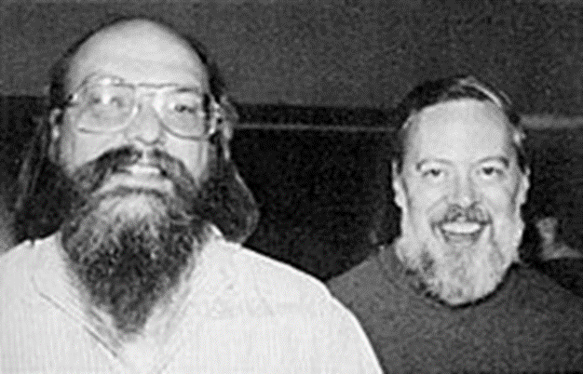


History of Linux
The Unix operating system was developed by Ken Thompson and Dennis Ritchie at
AT & T Bell LAB in 1969 and released in 1970.

Slide 3
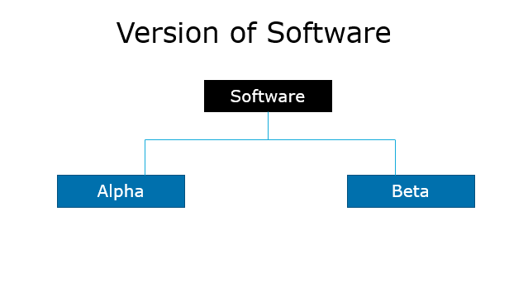
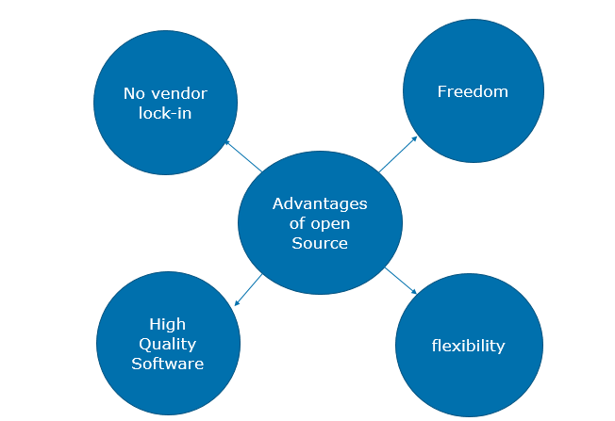
Software

Slide 4
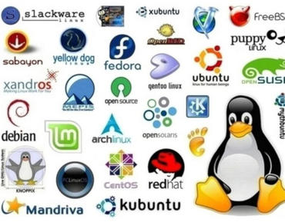
Distribution of Linux

Slide 5
Linux Subsystem
LINUX
USER APPLICATION
OS SERVICES
HARDWARE CONTROL
LINUX KERNEL

Slide 6
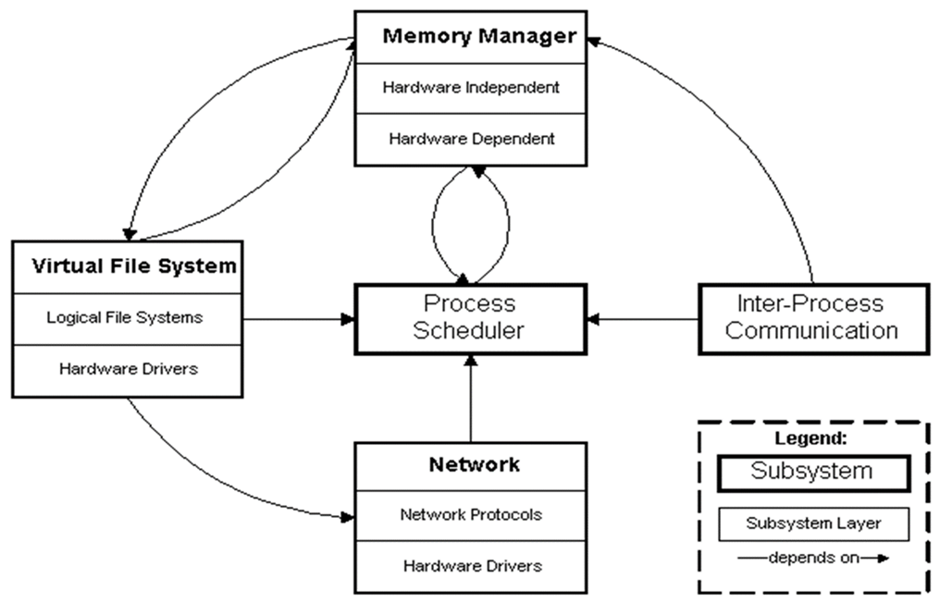
Kernel Subsystem

Slide 7
Booting process
Power/On
BIOS
MBR
GRUB
RUNLEVEL
INIT
KERNEL

Slide 8
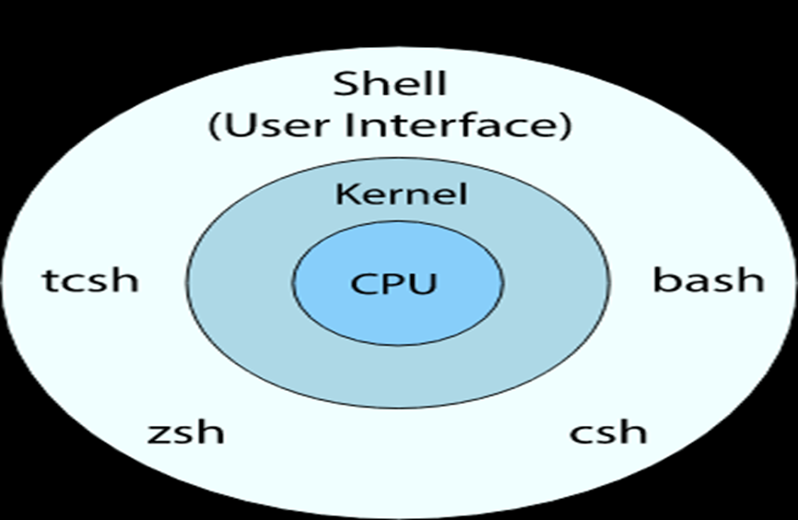
SHELL
Types of shell
Ash
Bourne
Bash
Corn
T-shell
C-shell
Z-shell

Slide 9
Run-levels
0-Halt
1-Single User mode
2-Multiuser mode without Network
3-Full multiuser mode
4-Unused
5-GUI
6-Reboot

Slide 10
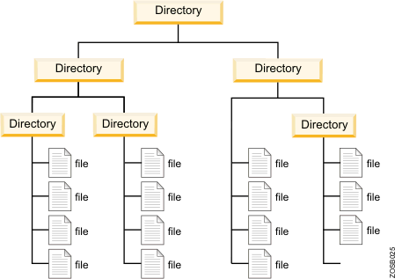
FILE SYSTEM
TYPES OF LINUX FILE SYSTEM
Ext 2
Ext 3
Ext 4
TYPES OF JOURNALING
Write back
Ordered
Data

Slide 11
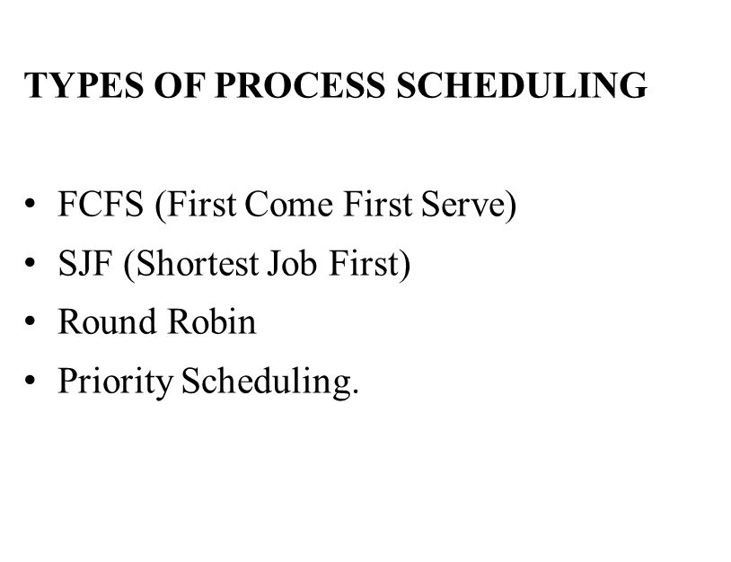
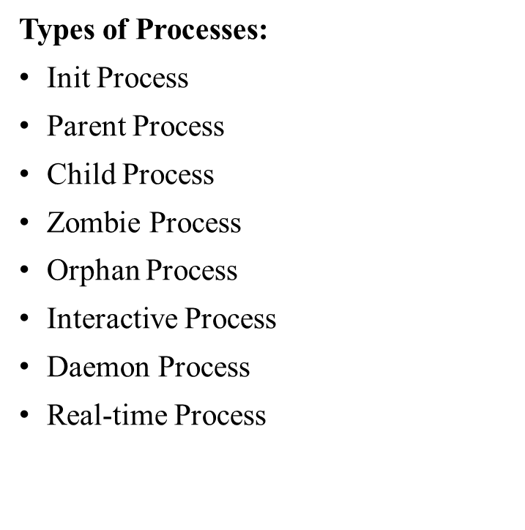
Process Management

Slide 12
DEVICE MANAGEMENT
Device files(/dev)
IRQ
Device Files
Character Devices
Block Devices

Slide 13
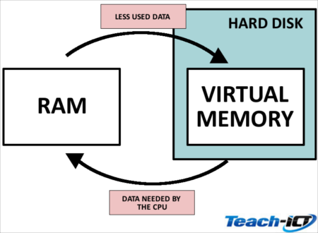
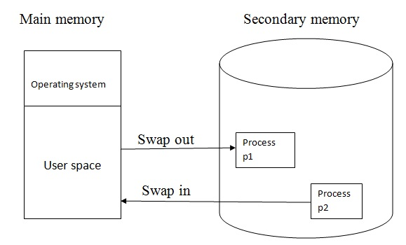
Memory Management
Virtual memory
Memory swapping
Memory Management Algorithms
BUDDY Algorithm
LRU

